Slide 1
Comp 4350 Software Engineering II Lecture 8
Dr. Shaowei Wang

Slide 2
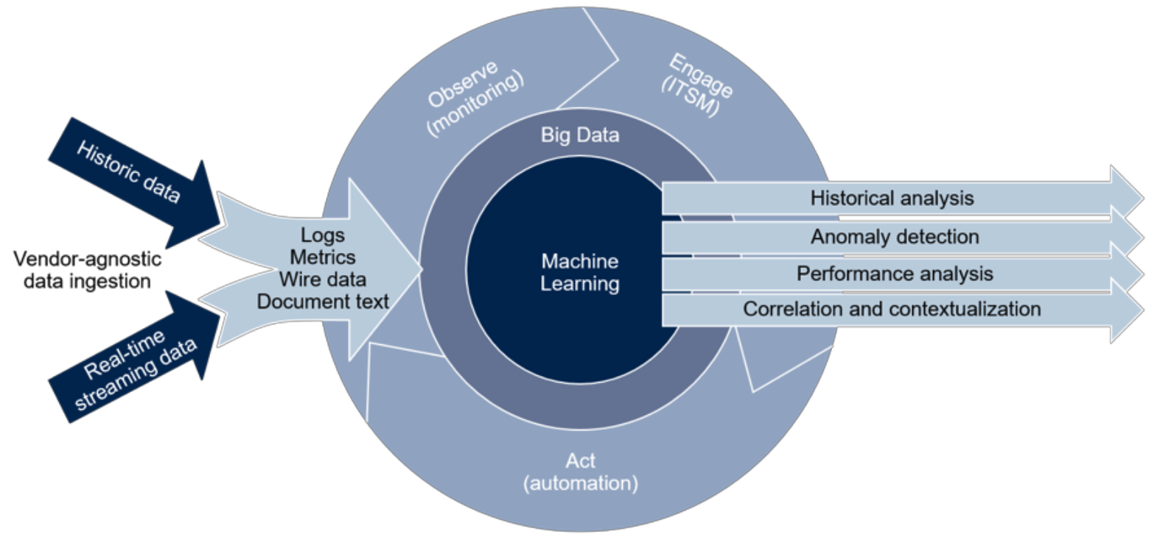
AIOps (Artificial Intelligence for IT Operations)
AIOps enhances IT operations through greater insights by combining big data, machine learning and visualization
AIOps addresses the DevOps challenges with AI
From: 2018 Gartner
Notes:
Wire data: All data travels on the network, from user behavior to malware. Wire data is the result of continuously reassembling all those gigabytes of data into full transactions, flows, and sessions—the only way to see and analyze everything communicating on your network in real time.
ITSM: Information Technology Service Management is the activities that are performed by an organization to design, plan, deliver, operate and control information technology services offered to customers.

Slide 3

Sub-topics of AIOps research
Autonomous configuration
Log abstraction
Fault diagnostics
Automated logging
Anomaly detection
Logging practices
Performance analysis
Software System
AIOps infrastructures
System comprehension
Incident prediction
Monitoring code made right
Monitoring data used right

Slide 4
Agenda
Hand-on tutorial for anomaly detection
Practices of using machine learning techniques

Slide 5
Hand-on tutorial for Anomaly Detection

Slide 6
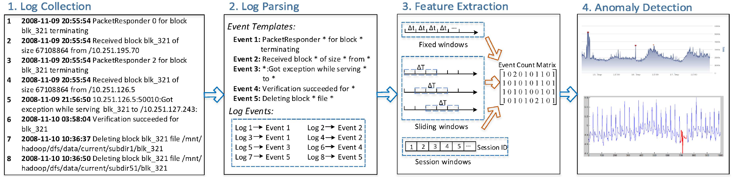
Hands-on tutorial: Analyzing System Logs for Anomaly Detection
Log Collection
Log Parsing
Feature Extraction
Anomaly Detection
Hadoop distributed file system(DFS)
He et al., Experience Report: System Log Analysis for Anomaly Detection. ISSRE ‘16.
Notes:
HDFS () logs

Slide 7
Hands-on tutorial: Analyzing System Logs for Anomaly Detection
Log Collection
Log Parsing
Feature Extraction
Anomaly Detection
Goal: Detect anomaly behavior on each block
He et al., Experience Report: System Log Analysis for Anomaly Detection. ISSRE ‘16.

Slide 8
Hands-on tutorial: Analyzing System Logs for Anomaly Detection
Log Collection
Log Parsing
Feature Extraction
Anomaly Detection
GitHub repo:
https://github.com/shaoweiwang2010/SEII-AIOps_data
He et al., Experience Report: System Log Analysis for Anomaly Detection. ISSRE ‘16.

Slide 9
Hands-on tutorial: follow-up tasks
Using correlation analysis to reduce the feature dimension before fitting the model
Using PCA analysis to reduce the feature dimension before fitting the model
Mining frequent patterns in the logs and summarize the frequent normal and abnormal patterns
Clustering log sequences based on the counts of each log event in a sequence
Classify the anomaly of each log line using a bag of words and treat log level as an ordinal variable

Slide 10
Common machine learning techniques
Classification
Clustering
Dimension reduction

Slide 11
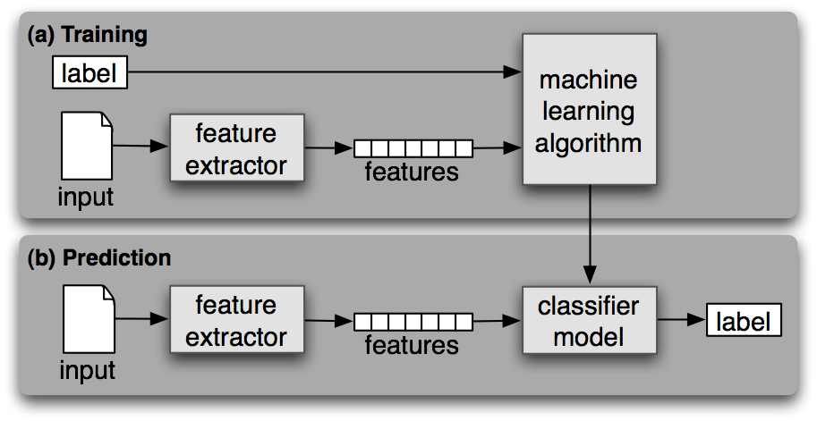
Two steps process - classification
Training and Testing sets, Model construction, Model Evaluation
->classifying future or unknown objects
Evaluation metrics: Accuracy, Precision, Recall, F-measure, AUC, MAP, etc.
Notes:
Training set is used to estimate parameters for the model. And the model is used to predict the label on unknown objects.

Slide 12
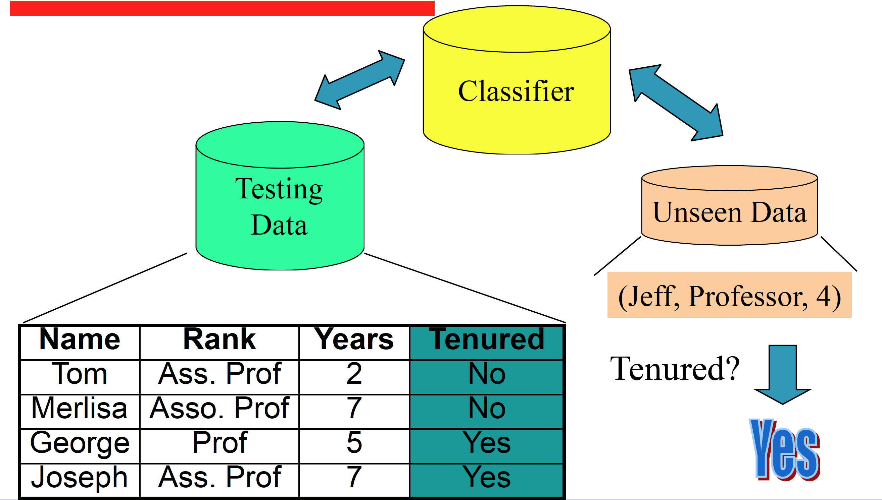
Model Application
From: A. E. Hassan and T. Xie: Mining Software Engineering Data

Slide 13
Different types of data in supervised learning
Data Types
Categorical
Numerical
Binary
Nominal
Ordinal
Continuous
Discrete
English, French, Spanish
Beginner, intermediate, advanced
True, False
1.76 m,
65.0 kg
60-70 kg,
70-80 kg

Slide 14
Encoding categorical data into numerical data
Data Types
Categorical
Numerical
Binary
Nominal
Ordinal
Continuous
Discrete

Slide 15
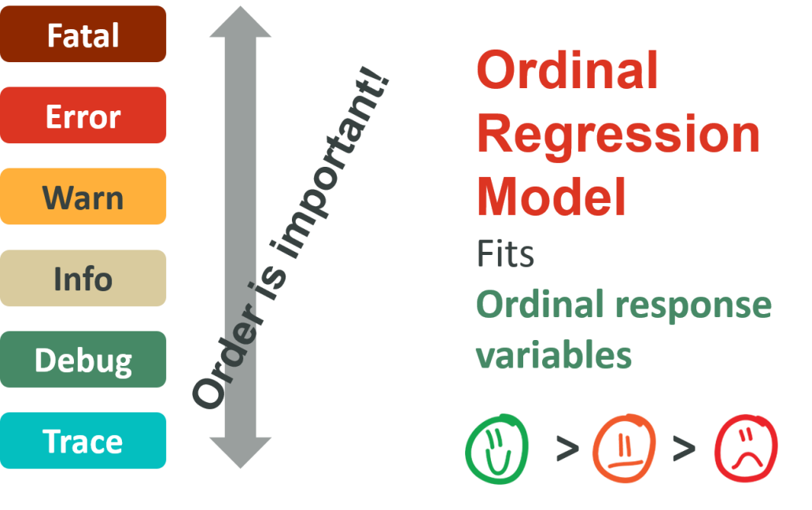
Ordinal data
Fatal
Logging statement metrics
Error
Containing block metrics
Warn
Containing file metrics
Info
Code change metrics
Ordinal Regression Model
Debug
Historical change metrics
Trace
Li et al., Which log level should developers choose for a new logging statement? EMSE ‘17.

Slide 16
Handling different types of data in supervised learning
First of all, consider the right models
Some models cannot handle categorical data directly (e.g., linear regression model)
Some models can handle categorical response variables but not categorical explanatory variables (e.g., logistic regression model)
Some models can handle both categorical response variables and categorical explanatory variables (e.g., decision tree-based models, random forest)
Some models provide special handling for certain data types (e.g., ordinal regression model for ordinal data)

Slide 17

Commonly used classification models
Random forest
construct a forest of decision trees, and get the final prediction based on the votes of each decision tree.

Slide 18
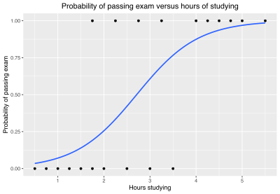
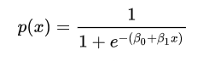
Commonly used classification models
Logistic regression
Notes:
Using the logit function.

Slide 19
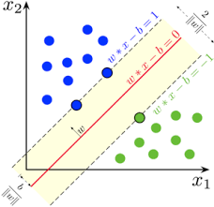
Commonly used classification models
Support vector machine
Map the data points into a space, so that the margin between two classes is maximized.
Notes:
Map the data points into a space, so that the margin between two classes are maxminzed.

Slide 20
Starting from the simple one first
Logistic regression, which is explainable
understanding indicator is the most important one to predict a failure of cloud node
Random forest
Achieve robust performance

Slide 21
Common machine learning techniques
Classification
Clustering
Dimension reduction

Slide 22











Two types of clustering
Hierarchical clustering
Partitional clustering
22

Slide 23
Algorithm k-means
1. Decide on a value for k (number of clusters).
2. Initialize the k cluster centers (randomly, if necessary).
3. Decide the class memberships of the N objects by assigning them to the nearest cluster center.
4. Re-estimate the k cluster centers, by assuming the memberships found above are correct.
5. If none of the N objects changed membership in the last iteration, exit. Otherwise goto 3.

Slide 24
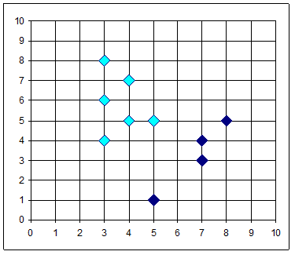
The K-Means Clustering Method
10
9
8
7
6
K=2
Arbitrarily partition the objects into K clusters
5
Compute the cluster means
4
3
2
1
0
0
1
2
3
4
5
6
7
8
9
10
Reassign
Reassign
Update the cluster means

Slide 25
Similarity is widely used in various machine learning techniques.

Slide 26
Clustering: the process of grouping a set of objects into classes of similar objects

Slide 27

Anomaly detection

Slide 28
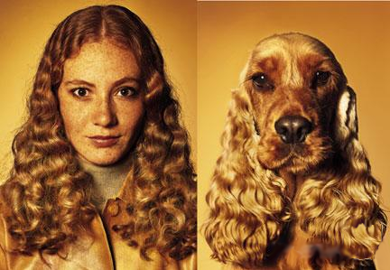
But, what is similarity?
The quality or state of being similar; likeness; resemblance; as, a similarity of features.
Webster's Dictionary

Slide 29
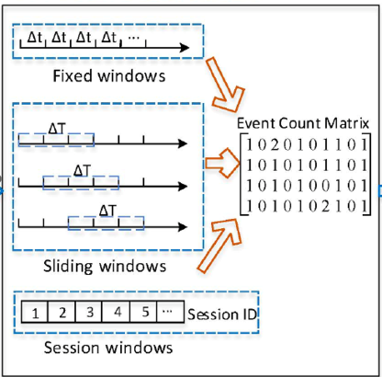


Feature engineering

Slide 30
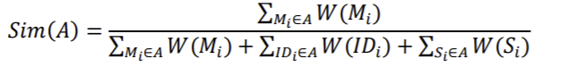
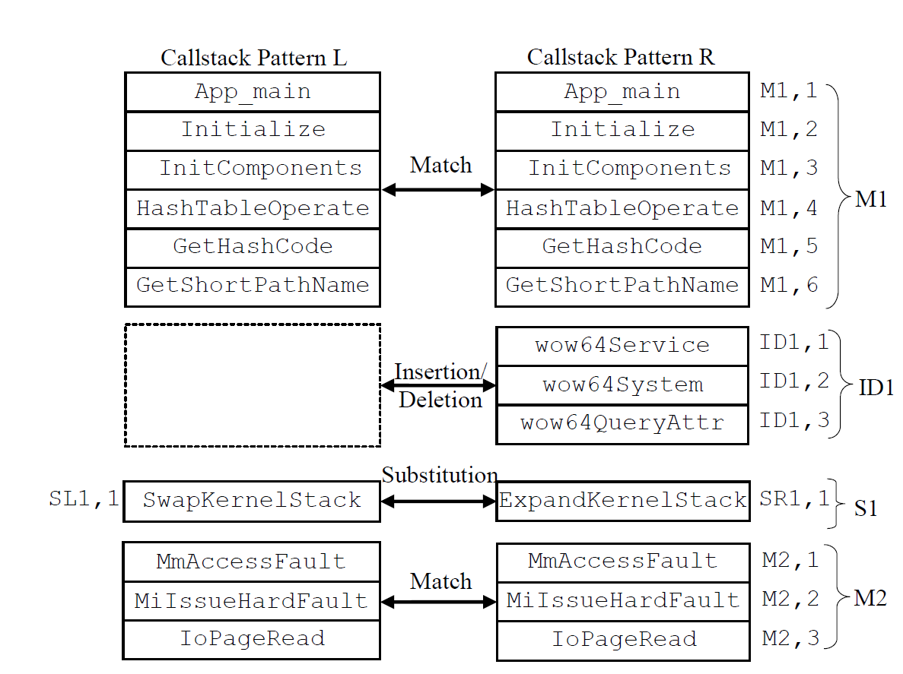
Define cost of alignment (edit cost) and get optimal alignment.
Notes:
Similarity = portion of match/ all components. More match , larger Numerator, more dismatch, larger denominator

Slide 31
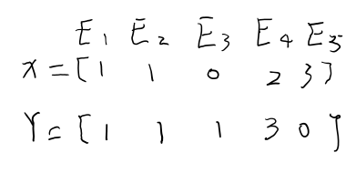
Similarity measures
How to determine similarity between data points
using various distance metrics
Let x = (x₁,…,x_{n}) and y = (y₁,…y_{n}) be n-dimensional vectors of data points of objects g₁ and g₂
Euclidean distance
Notes:
Material from “Data Analysis tools for DNA microarrays” by Sorin Draghici

Slide 32
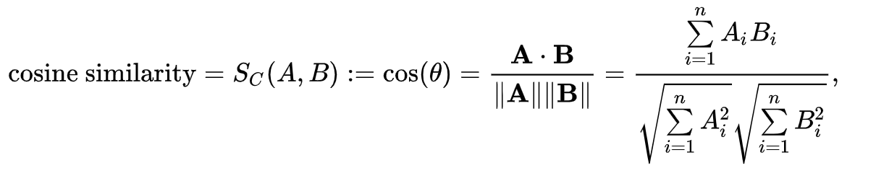
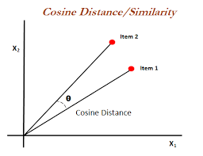
Cosine similarity

Slide 33
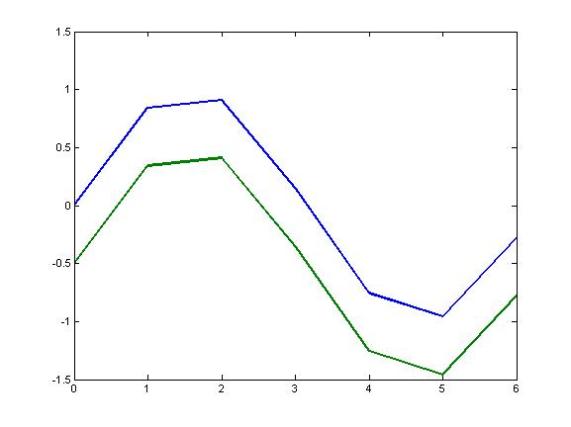
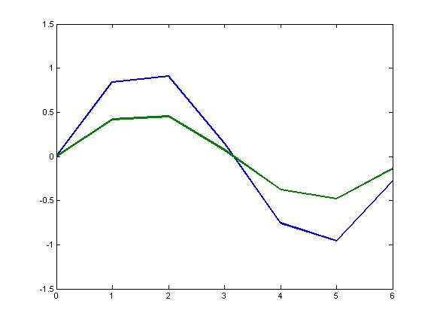
Similarity measures
Correlation distance

Slide 34
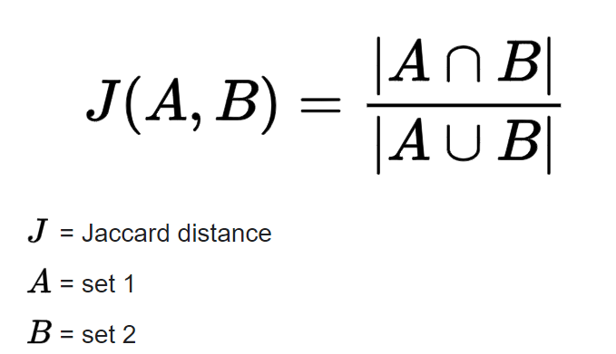
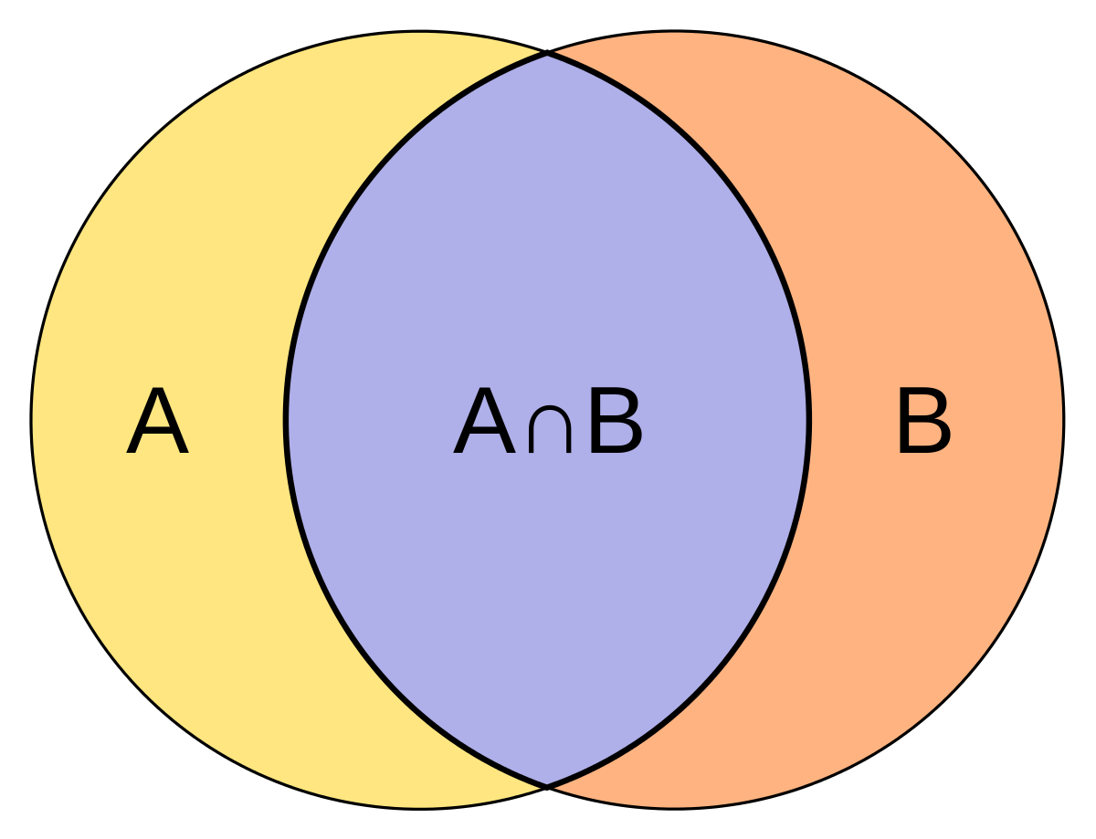
Jaccard Similarity

Slide 35
Common machine learning techniques
Classification
Clustering
Dimension reduction

Slide 36
Perf regression analysis usually needs to examine hundreds of perf metrics
+
=
Perf metrics
CPU
Memory
Response time
…
Logs
Warnings
Errors
Exceptions
…
Heavy tasks for performance engineers

Slide 37
Blue force approach
One way to fully understand the effect of the configuration parameters (more than 100) on system performance is to exhaustively run different combinations of the parameter values.
However, too many combination to test
5 parameters, and each parameter has 10 settings, we have 10^5 combination!
Infeasible! Each combination requires several hours to run.
What if coming with hundreds of parameters?

Slide 38
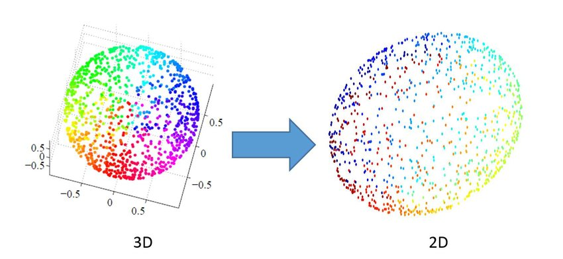
Dealing with high dimensionality
Notes:
1) Visualization 2) calculation

Slide 39
Understanding the relationship between config. parameters and performance metrics
Perf. critical parameters
Perf. related parameters
Perf. data
Asking domain experts
Running tests
Multivariate Adaptive Regression
Splines (MARS)
Only a few out of many candidate parameters significantly impact system performance and reduce the search space.
[Li et al. 2018]
Notes:
we performed a sensitivity analysis to understand the configuration parameters’ impact on the system performance. Specifically, we built Multivariate Adaptive Regression Splines (MARS) [6] models to understand the relationship between the parameters and the performance measures. The significant parameters will be selected and will be tuned.

Slide 40
Feature importance
How much contribution of a feature (e.g., Cache.size,Fetch.blocksize) makes to the prediction power of a model (e.g., average query response time)
More contribution of a feature makes, more important it is

Slide 41
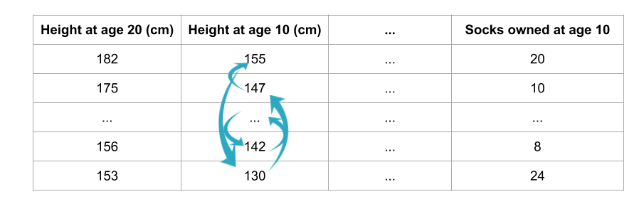
Permutation feature importance
After evaluating the performance of your model, you permute the values of a feature of interest and reevaluate model performance.
If more performance drops due to the permutation, more importance it is; otherwise, less importance
It is a model-agnostic approach
Cache.size
average query response time
Fetch.blocksize

Slide 42



















Dimension reduction – Principle Component Analysis (PCA)
PCA transforms a set of correlated variables into a reduced set of uncorrelated variables (principle components, or PC)
Each PC is a linear combination of the original variables
A smaller number of PCs can explain the variance of the original variables

Slide 43
Dimension reduction – correlation analysis
Y = a1*X1 + a2 * X2 + a3 * X3
If X1 = b2 * X2 + b3 * X3, we can remove X1, and since we can use X2 and X3 to represent X1.

Slide 44
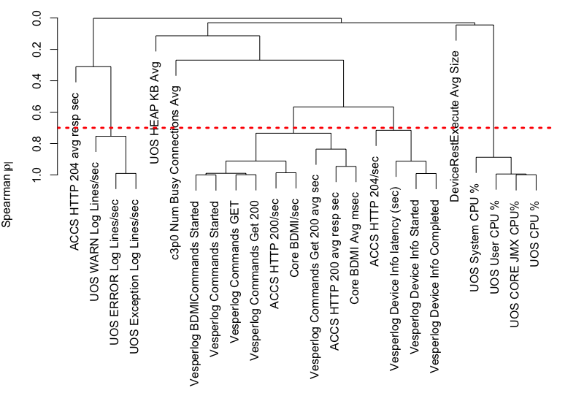
Dimension reduction – correlation analysis

Slide 45
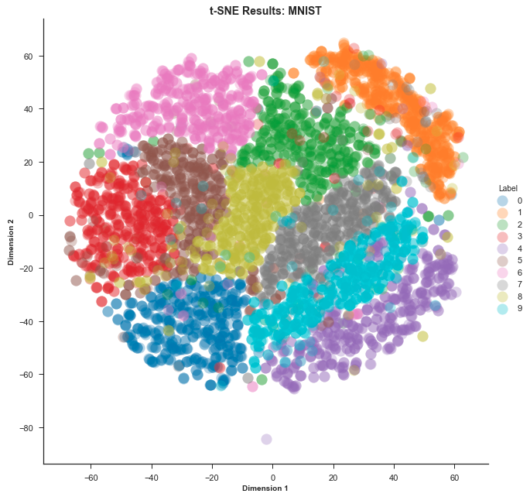
Other dimension reduction techniques
t-Distributed Stochastic Neighbor Embedding (t-SNE):
A prize-winning technique for dimensionality reduction that is particularly well suited for the visualization of high-dimensional datasets
Idea is simple: models each high-dimensional object by a two- or three-dimensional point in such a way that similar objects are modeled by nearby points and dissimilar objects are modeled by distant points with high probability.

Slide 46
Exercise: select the most appropriate techniques for different scenarios
Your monitoring data recorded user behaviors (e.g., browsing items, purchasing items, etc.) in an E-commerce system. You want to find the patterns of user behaviors (e.g.., browsing item A following purchasing item B). Which technique will you use?
Classification
Clustering
Frequent Pattern Mining
Dimension Reduction

Slide 47
Tools and Datasets

Slide 48
Available tools
Industrial solutions:
Application Performance Management (APM) Tools: e.g., AppDynamics, New Relic, Dynatrace, and Pinpoint (open source)
Log Management Tools: e.g., Splunk, ELK Stack (open source), Loggly, and Graylog
Academic tools:
LogPAI (https://github.com/logpai) : log parsers, anomaly detection, where to log

Slide 49
Public Datasets
Loghub (https://github.com/logpai/loghub): a collection of system logs generated by different systems
Azure VM traces (https://github.com/Azure/AzurePublicDataset): two representative traces of the virtual machine (VM) workload of Microsoft Azure collected in 2017 and 2019.
Google cluster traces (https://github.com/google/cluster-data/blob/master/ClusterData2011_2.md)
Alibaba cluster traces (https://github.com/alibaba/clusterdata/wiki/About-Alibaba-cluster-and-why-we-open-the-data)

Slide 50
Reference
Li, Yangguang, et al. "Predicting Node Failures in an Ultra-large-scale Cloud Computing Platform: an AIOps Solution." TOSEM ‘20.
Lin et al., Predicting Node Failure in Cloud Service Systems. FSE ‘18.
Zhu et a., Learning to log: helping developers make informed logging decisions. ICSE ‘15.
El-Sayed et al. "Learning from failure across multiple clusters: A trace-driven approach to understanding, predicting, and mitigating job terminations." ICDCS ‘17.
Botezatu et al. "Predicting disk replacement towards reliable data centers." SIGKDD ‘16.
Xu, Wei, et al. "Detecting large-scale system problems by mining console logs." SOSP ‘09.

